Slide 1
Practice Lab:
This Practice Lab is dependent on Discussion Module 7447, where most of the objects we create in this lab were introduced.
This Practice Lab requires a working DSE system, with DSE Search enabled, and with ability to execute CQL DDL.
No command line prompt is required.
All commands are run from CQLSH, or DSE Studio.
DSE Search, Scalars, docValues, KeywordTokenizer
Notes:
The goal of this Practice Lab is to create a number of scalar DSE Search indexes.
Runtime requirements are detailed in the slide above.

Slide 2
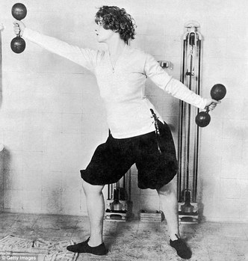
Challenge 1: AND(ed) String and Integer
Create the runtime environment to support an AND(ed) query, using a StrField and an Integer
Sample CQL DDL/DML commands on notes page below-
Notes:
CQL syntax to harvest from:
DROP KEYSPACE ks_7447;
CREATE KEYSPACE ks_7447 WITH REPLICATION =
{'class': 'SimpleStrategy', 'replication_factor': 1};
USE ks_7447;
CREATE TABLE t3
(
col1 TEXT,
col2 TEXT,
col3 TEXT,
col4 TEXT,
col5 TEXT,
col6 DOUBLE,
col7 INT,
col8 DOUBLE,
col9 INT,
col0 TEXT,
PRIMARY KEY ((col1, col2)) );
CREATE SEARCH INDEX ON t3 WITH COLUMNS col1,
* { excluded : true };
// /////////////////////////////////////////////////////
INSERT INTO t3
(col1, col2, col3, col4, col5,
col6, col7, col8, col9, col0)
VALUES ('aaa', 'aaa', 'Dave', 'Dave', 'aaa',
17.76, 17, 17.76, 17, 'aaa');
INSERT INTO t3
(col1, col2, col3, col4, col5,
col6, col7, col8, col9, col0)
VALUES ('bbb', 'bbb', 'David', 'David', 'bbb',
17.092, 17, 17.092, 17, 'bbb');
INSERT INTO t3
(col1, col2, col3, col4, col5,
col6, col7, col8, col9, col0)
VALUES ('ccc', 'ccc', 'Davidia', 'Davidia', 'ccc',
16.003, 16, 16.003, 16, 'ccc');
INSERT INTO t3
(col1, col2, col3, col4, col5,
col6, col7, col8, col9, col0)
VALUES ('ddd', 'ddd', 'Sophie', 'Stinky', 'ddd',
16.00002, 16, 16.00002, 16, 'ddd');
// /////////////////////////////////////////////////////
ALTER SEARCH INDEX SCHEMA ON t3
ADD types.fieldtype[@class='org.apache.solr.schema.StrField',
@name='StrField53'];
ALTER SEARCH INDEX SCHEMA ON t3 ADD fieldType[@name='TextField54',
@class='solr.TextField'] WITH
'{"analyzer":{"tokenizer":{"class":"solr.KeywordTokenizerFactory"},
"filter":{"class":"solr.LowerCaseFilterFactory"}}}';
ALTER SEARCH INDEX SCHEMA ON t3
ADD types.fieldtype[@class='org.apache.solr.schema.TrieDoubleField',
@name='TrieDoubleField55'];
ALTER SEARCH INDEX SCHEMA ON t3
ADD types.fieldtype[@class='org.apache.solr.schema.TrieIntField',
@name='TrieIntField56'];
// /////////////////////////////////////////////////////
ALTER SEARCH INDEX SCHEMA ON t3 ADD fields.field[@name='col3',
@type='StrField53', @docValues='true'];
ALTER SEARCH INDEX SCHEMA ON t3 ADD fields.field[@name='col4',
@type='TextField54', @docValues='true'];
ALTER SEARCH INDEX SCHEMA ON t3 ADD fields.field[@name='col6',
@type='TrieDoubleField55', @docValues='true'];
ALTER SEARCH INDEX SCHEMA ON t3 ADD fields.field[@name='col7',
@type='TrieIntField56', @docValues='true'];
RELOAD SEARCH INDEX ON t3;
REBUILD SEARCH INDEX ON t3;
// /////////////////////////////////////////////////////
SELECT * FROM t3
ORDER BY col6 ASC, col7 DESC, col3 ASC;
SELECT * FROM t3
WHERE col6 > 12.0 AND col7 < 26;
// The statement below fails
SELECT * FROM t3
WHERE col6 > 12.0 OR col7 < 26;
SELECT * FROM t3
WHERE solr_query = 'col6:[12.0 TO *] OR col7:[* TO 26]';
//
SELECT * FROM t3
WHERE solr_query = 'col6:[12.0 TO *] AND col7:[* TO -10]';
// The statement below fails
SELECT * FROM t3
WHERE solr_query = 'col6:[12.0 TO *] AND col7:[* TO 26]' ORDER BY col6 ASC;
SELECT * FROM t3
WHERE solr_query = '{"q" : "col6:[12.0 TO *] AND col7:[* TO 26]", "sort":"col6 ASC, col7 DESC, col3 ASC" }';
// /////////////////////////////////////////////////////
SELECT * FROM t3
WHERE col3 LIKE 'Dav%';
SELECT * FROM t3
WHERE col3 LIKE 'dav%';
SELECT * FROM t3
WHERE col4 LIKE 'Dav%';
SELECT * FROM t3
WHERE col4 LIKE 'dav%';
SELECT * FROM t3
WHERE col4 LIKE '%av%';
// /////////////////////////////////////////////////////
// col6/col8 values: 17.76, 17.092, 16.003, 16.00002
DROP SEARCH INDEX ON t3;
CREATE SEARCH INDEX ON t3 WITH COLUMNS col1,
* { excluded : true };
ALTER SEARCH INDEX SCHEMA ON t3
ADD types.fieldtype[@class='org.apache.solr.schema.TrieDoubleField',
@name='TrieDoubleField61', @precisionStep='16'];
ALTER SEARCH INDEX SCHEMA ON t3
ADD types.fieldtype[@class='org.apache.solr.schema.TrieDoubleField',
@name='TrieDoubleField62', @precisionStep='4'];
ALTER SEARCH INDEX SCHEMA ON t3 DROP fields.field[@name='col6'];
ALTER SEARCH INDEX SCHEMA ON t3 ADD fields.field[@name='col6',
@type='TrieDoubleField61', @docValues='true'];
ALTER SEARCH INDEX SCHEMA ON t3 ADD fields.field[@name='col8',
@type='TrieDoubleField62', @docValues='true'];
RELOAD SEARCH INDEX ON t3;
REBUILD SEARCH INDEX ON t3;
select col1, col6, col8 from t3;
SELECT col1, col6, col8 FROM t3
WHERE solr_query = 'col8:[17 TO 18]';
SELECT col1, col6, col8 FROM t3
WHERE solr_query = 'col8:[15.9 TO 16.00003]';
SELECT col1, col6, col8 FROM t3
WHERE solr_query = 'col6:[15.9 TO 16.00003]';

Slide 3
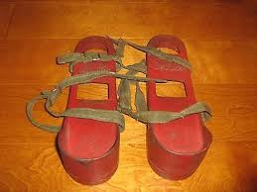
Challenge 2: Lowercase (TextField) with Sort
Create the runtime environment to support a lowercase TextField query, and output results in a sorted manner
Sample CQL DDL commands on previous notes page-
Notes:
Design and deliver the runtime statements and query to deliver the above-

Slide 4
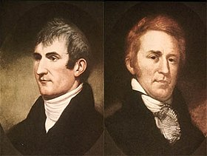
Go Farther: (Optional)
The Lewis and Clark Expedition from May 1804 to September 1806, also known as the Corps of Discovery Expedition, was the first American expedition to cross what is now the western portion of the United States.
Source: https://en.wikipedia.org/wiki/Lewis_and_Clark_Expedition/
Notes:
Go farther in this Practice Lab: given sample syntax, build something new.

Slide 5
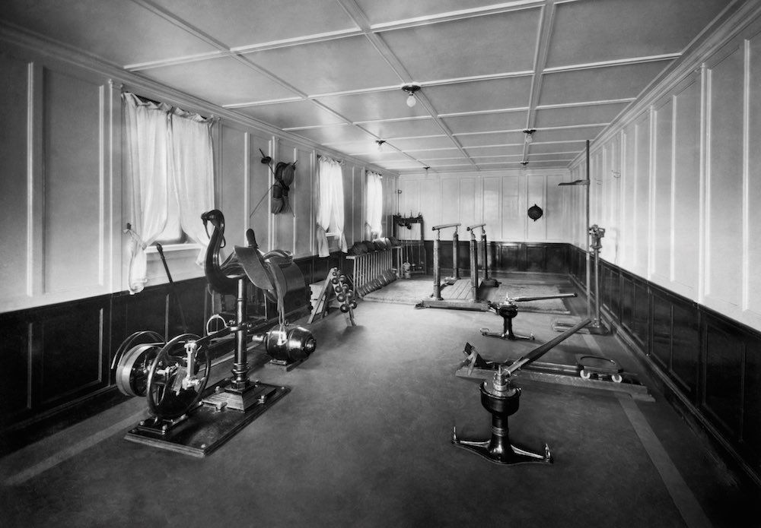
Challenge 3 (Optional): multiValued, tags
Create the runtime environment and query to support-
A multiValued field
Add data, similar to attribute tags on a product row
Write the query to find a subset of rows
Sample CQL DDL/DML commands on notes page below-
Notes:
Sample syntax to harvest ideas from, and apply to the goals outlined on the this page.
CREATE TABLE t4
(
col1 TEXT,
col2 TEXT,
col3 TEXT,
col4 TEXT,
col8 SET<TEXT>,
PRIMARY KEY (col1)
);
INSERT INTO t4 (col1, col8)
VALUES ('colas', { 'Coke', 'Pepsi'} );
INSERT INTO t4 (col1, col8)
VALUES ('better than colas', { 'Mountain Dew', 'Mellow Yellow', 'Surge' } );

Slide 6
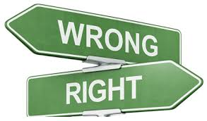
Practice Lab:
Lessons learned
Notes:
Discuss what worked well, poorly, from the Practice Lab.

Slide 7
End of Module:
Notes:
End of Practice Lab-

